Slide 1


Kansas Geological Survey Activities in Support of Groundwater Conservation Efforts in Wichita County
Wichita County Public Meeting
August 28, 2024
Kansas Geological Survey
University of Kansas

Slide 2
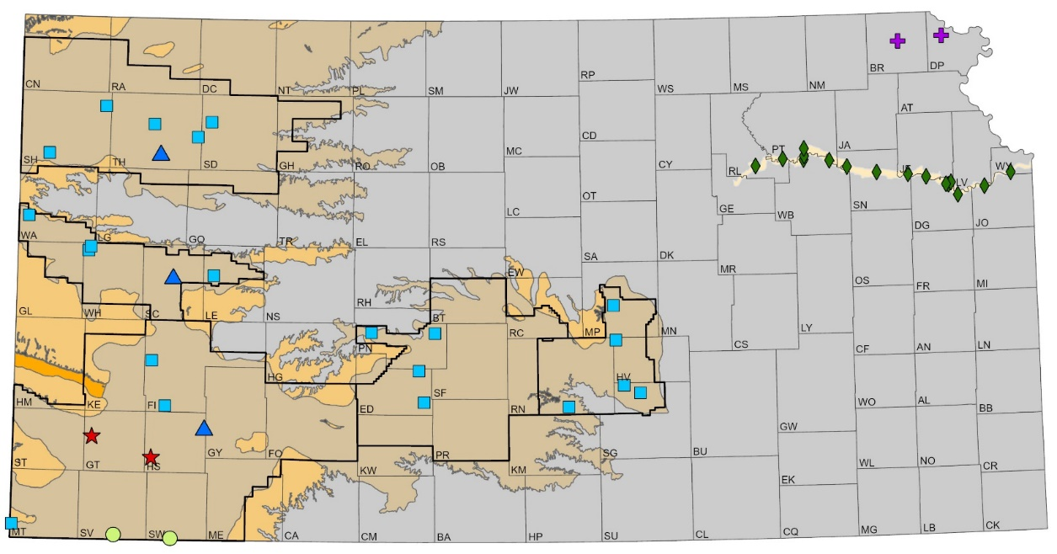
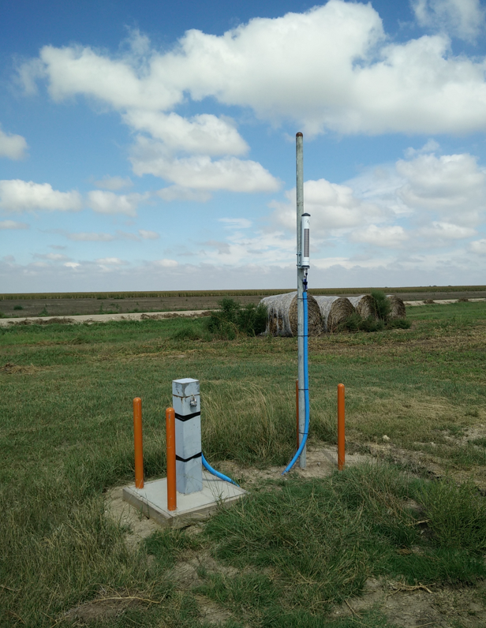
Kansas Index Well Program
Since monitoring began, end-of-season recovery is similar regardless of past pumping or climatic conditions
Kansas Geological Survey

Slide 3
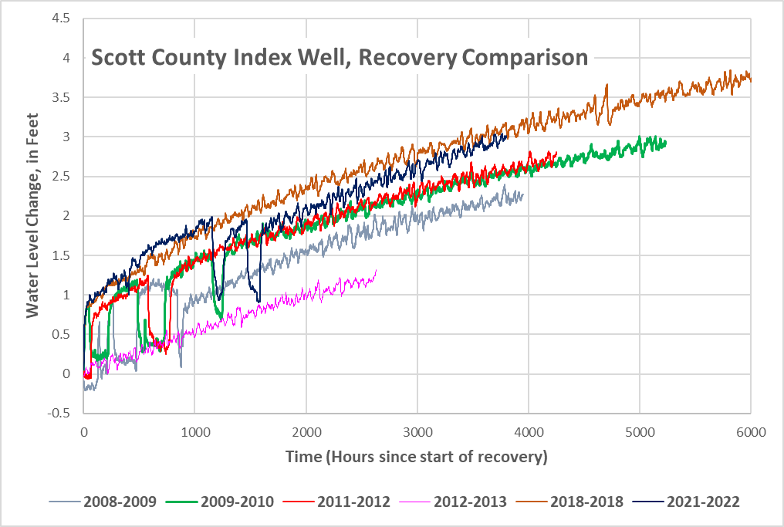
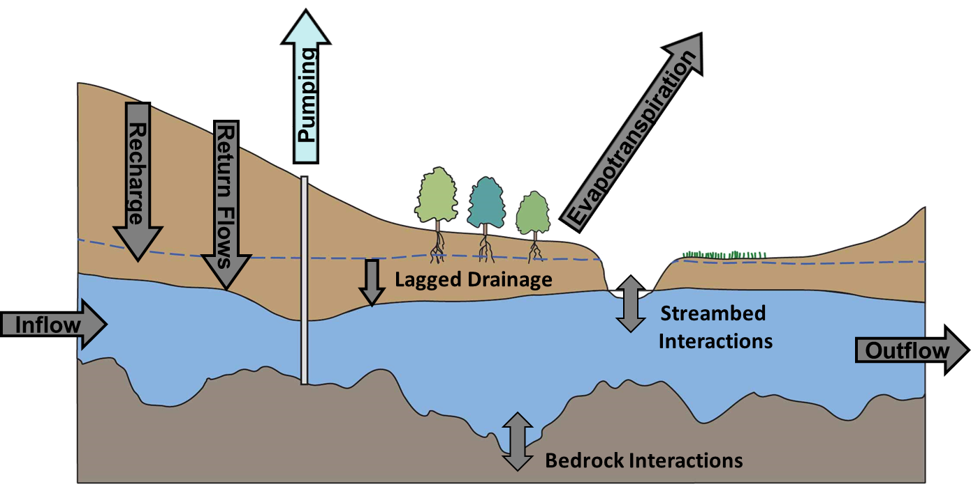
Index Wells Recovery Curves, Scott County
Water level change starting at the end-of-season pumping (September to April~June)
Recovery is similar each year
“Net Inflow”
  Everything flowing in and out of the aquifer except pumping
Kansas Geological Survey

Slide 4
Kansas Index Well Program
Since monitoring began, end-of-season recovery is similar regardless of past pumping or climatic conditions
Kansas Geological Survey

Slide 5
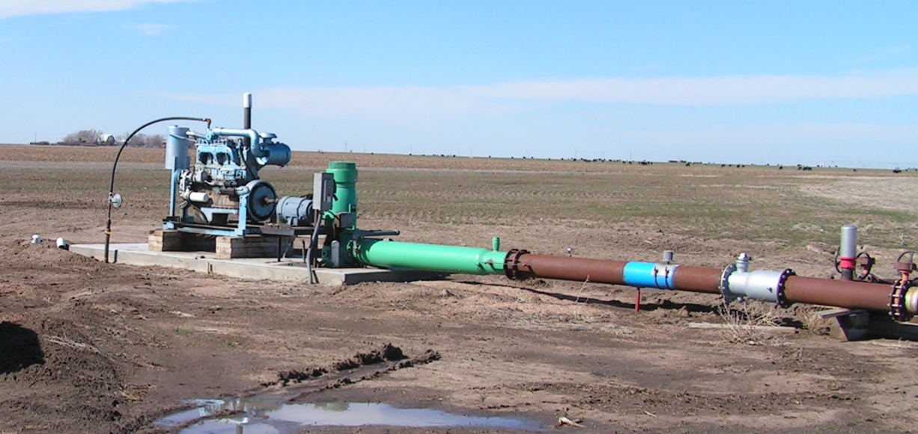
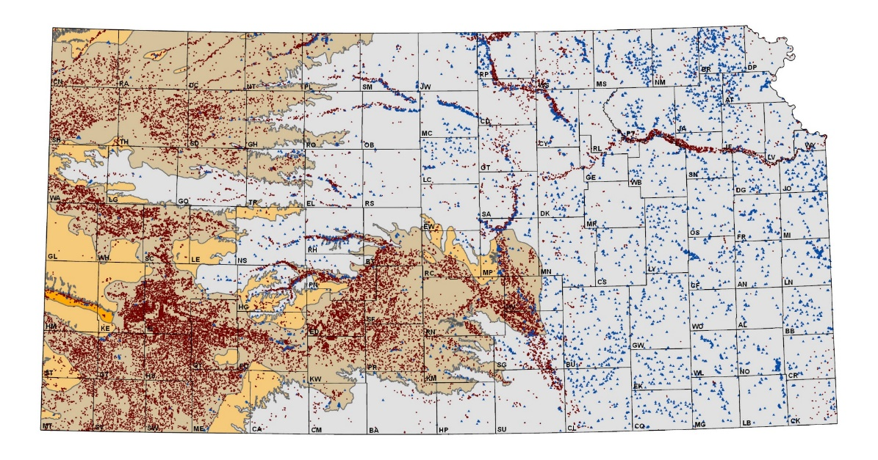
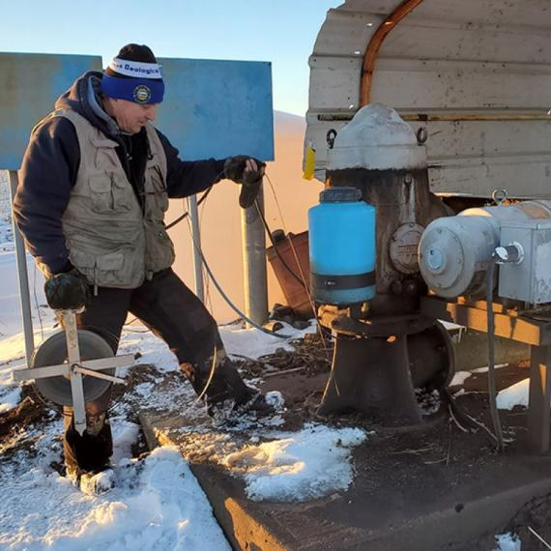
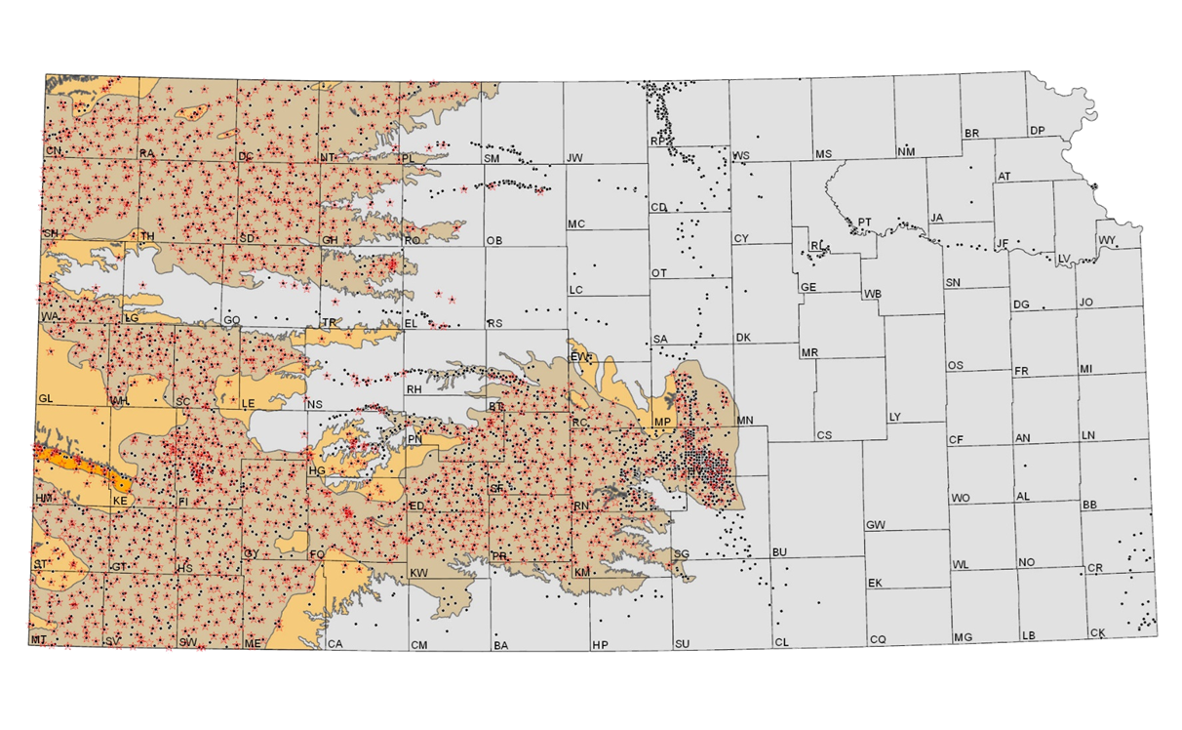
KGS Water Balance / Q-Stable Analysis
A simple approach to assess the relationship between average groundwater usage and water-level change
Well suited for Ogallala/High Plains aquifer
  Seasonally pumped
  Water is at depth
  Semi-arid region
Data driven with no conceptualizations
  Water use
  Water levels
Relationships should hold for the next one to three decades

Slide 6
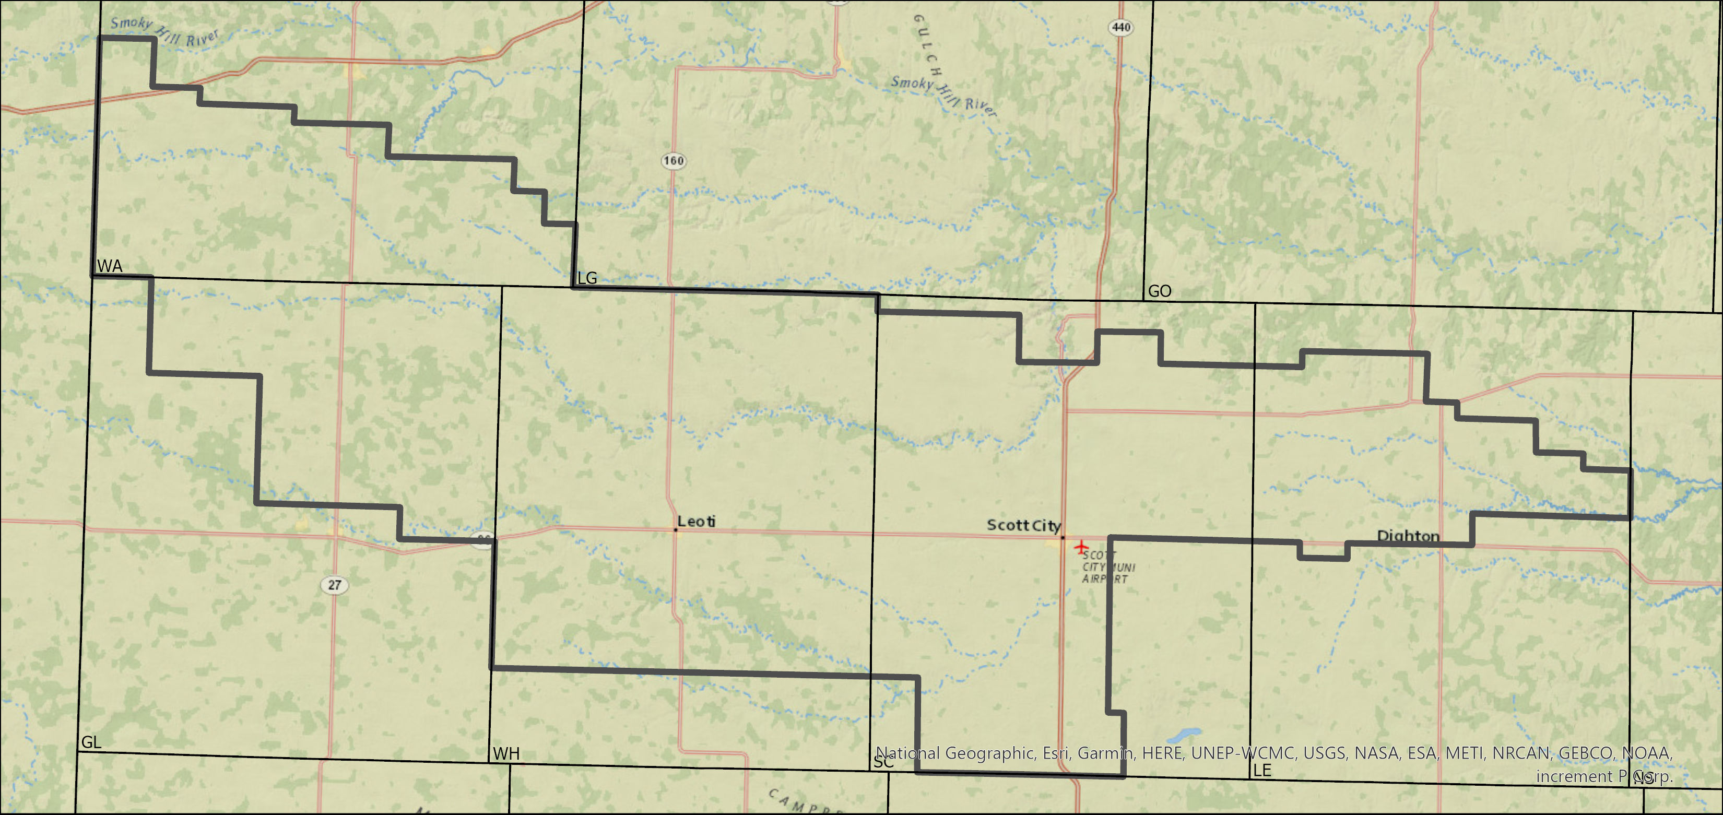
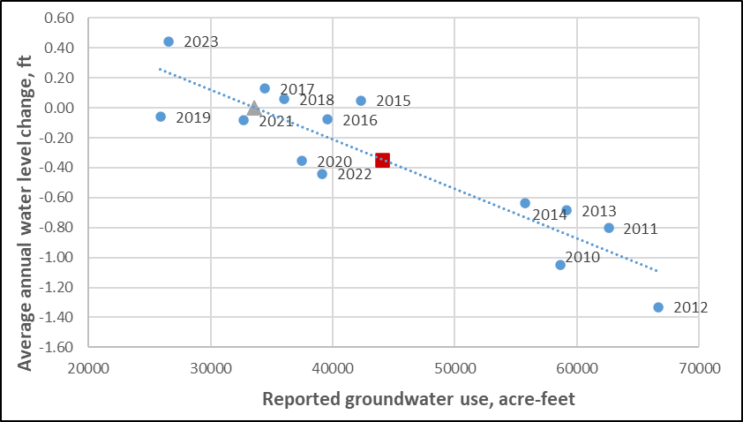
Wichita County
R-squared = 0.81, P < 0.00002
Average 2010-2023:
  Water-level change = -0.35 ft
  Total reported use = 44,066 AF
Average 2019-2023:
  Water-level change = -0.098 ft
  Total reported use = 32,351 AF
Net Inflows = 33,602 AF
Percent reduction for stable water levels:
  Average conditions = 24%
  Drought (2011) = 46%
  Last 5 years = 0%
Kansas Geological Survey

Slide 7
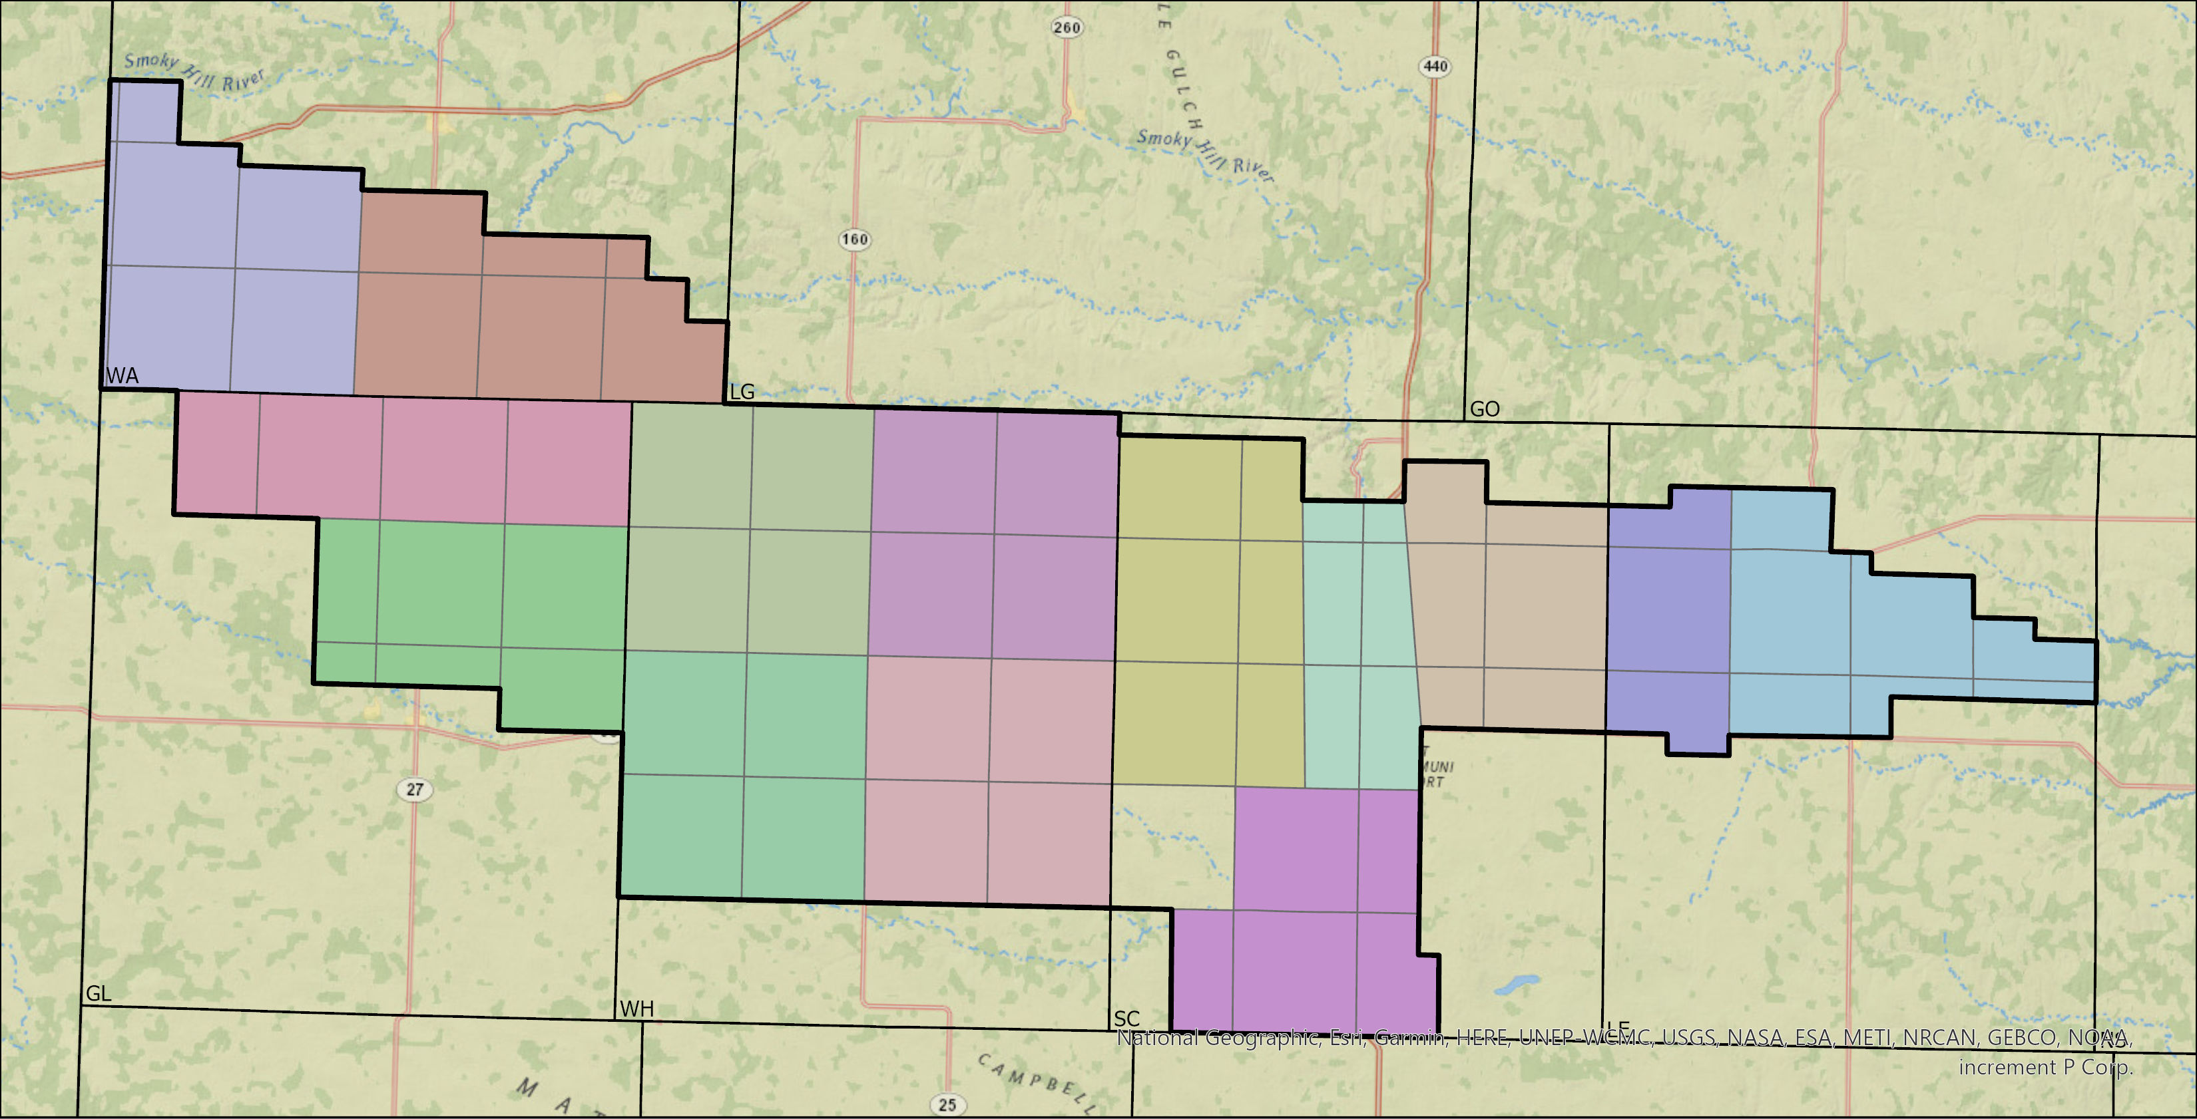
Township Scale Groups
Kansas Geological Survey

Slide 8
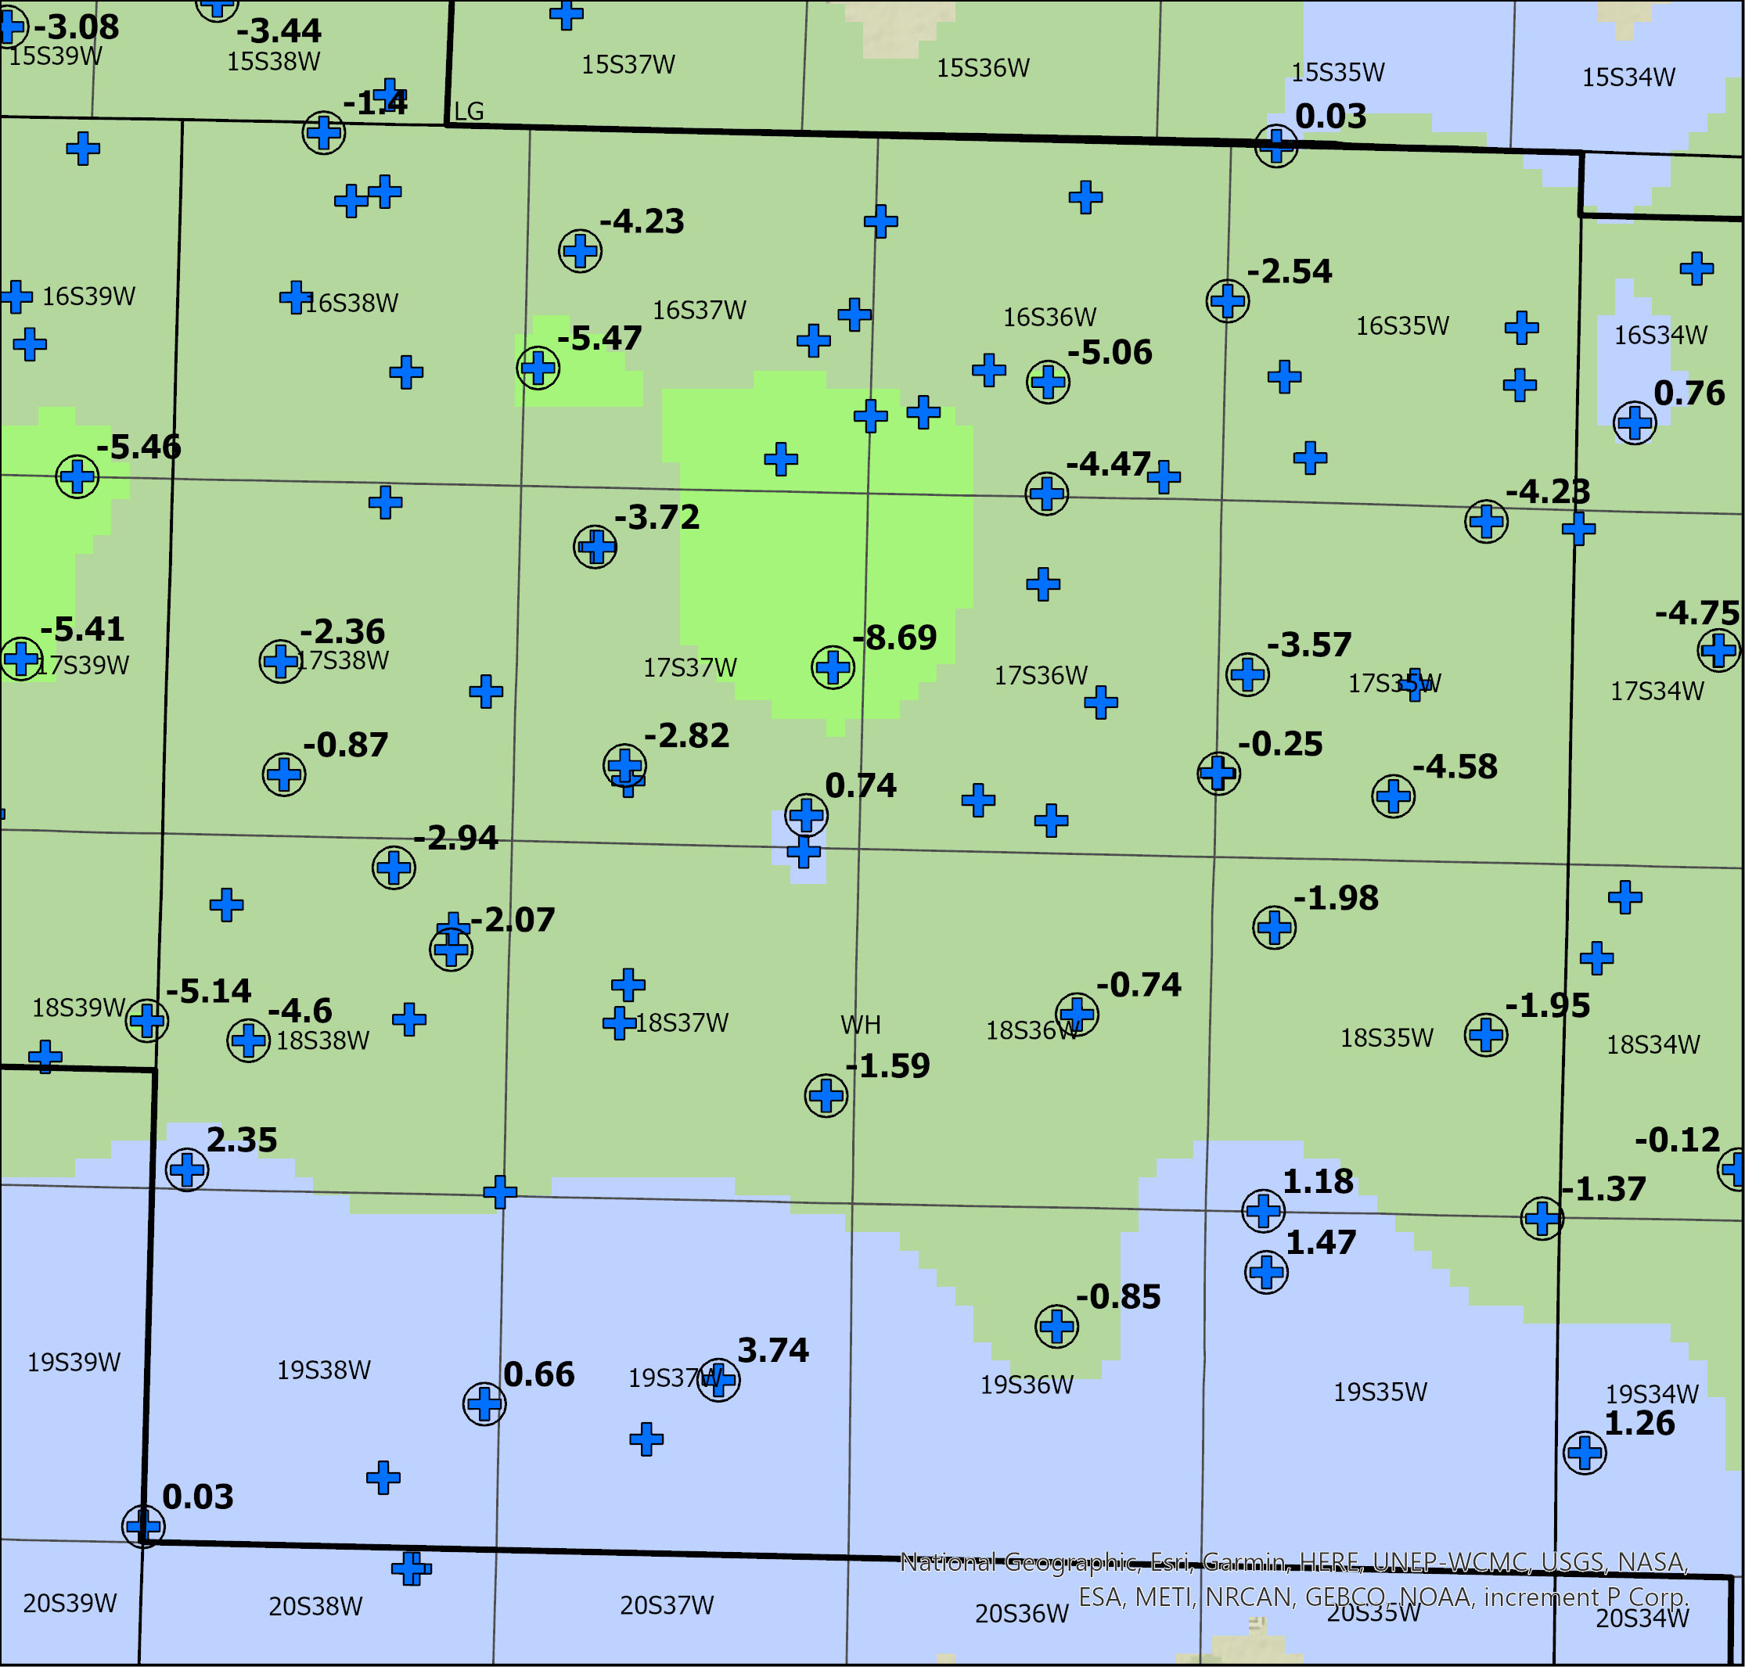
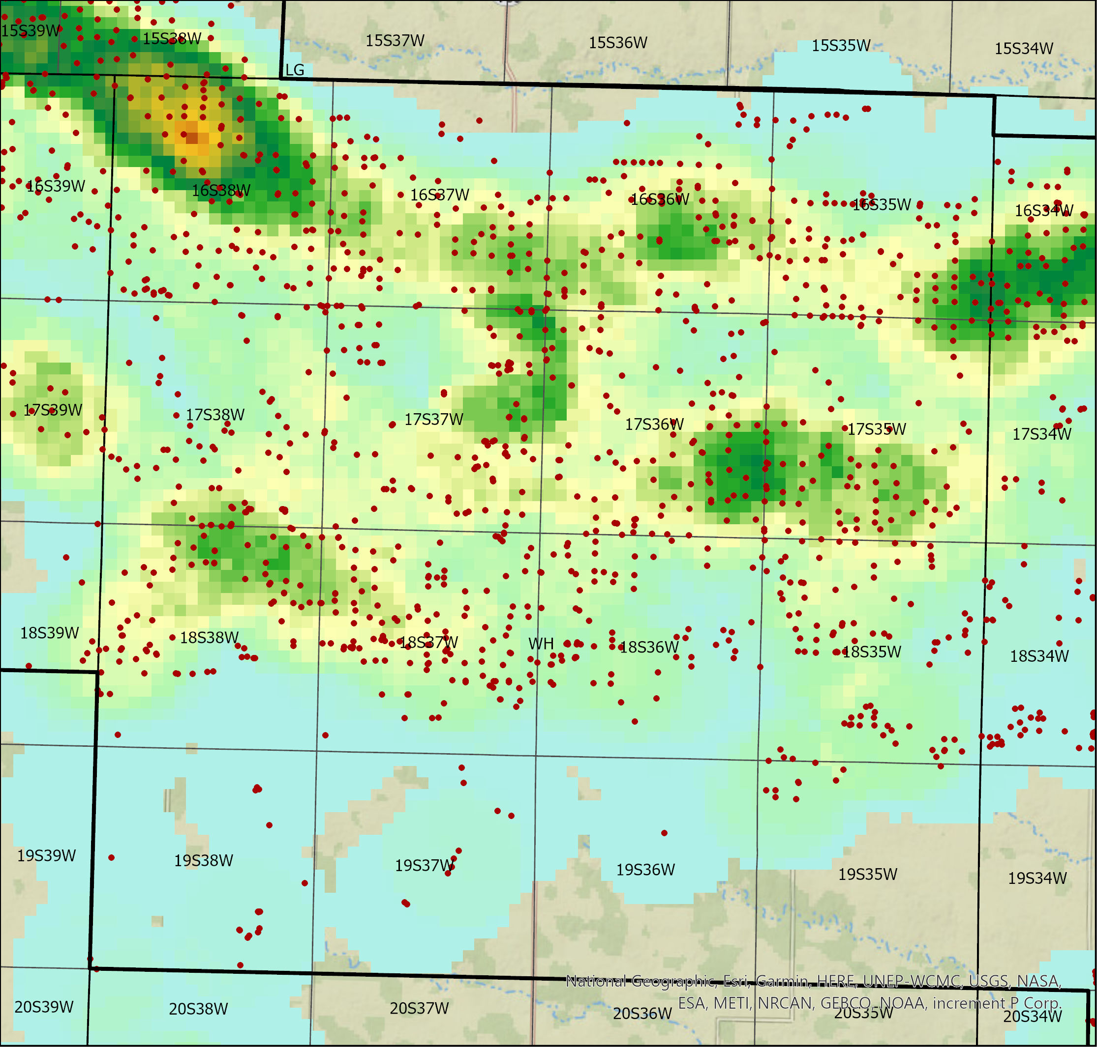

10-year water level change and water use density- Wichita County
Water-level Change in Feet
Water Use Density (AF/Acre- 2mile circle)
Kansas Geological Survey

Slide 9
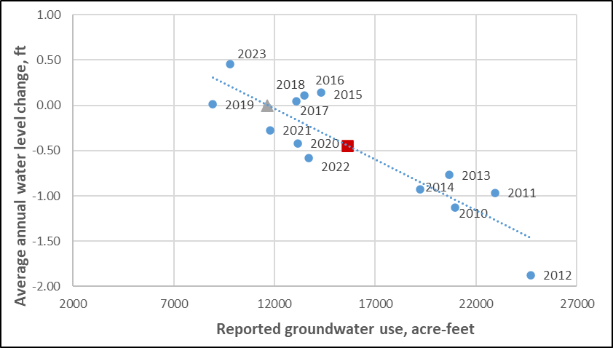
Wichita County Northeast
R-squared = 0.80, P < 0.00002
Average 2010-2023:
  Water-level change = -0.44 ft
  Total reported use = 15,599 AF
Average 2019-2023:
  Water-level change = -0.16 ft
  Total reported use = 11,478 AF
Net Inflows = 11,646 AF
Percent reduction for stable water levels:
  Average conditions = 25%
  Drought (2011) = 49%
  Last 5 years = 0%
Kansas Geological Survey

Slide 10
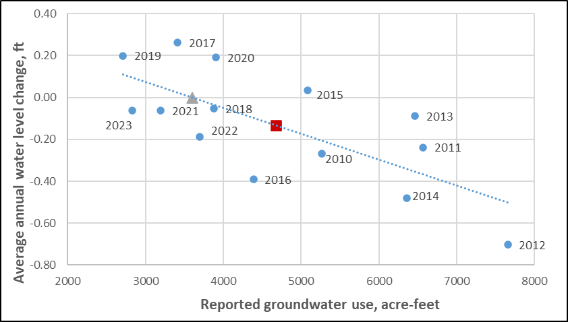
Wichita County Southeast
R-squared = 0.51, P < 0.005
Average 2010-2023:
  Water-level change = -0.13 ft
  Total reported use = 4,673 AF
Average 2019-2023:
  Water-level change = 0.016 ft
  Total reported use = 3,270 AF
Net Inflows = 3,605 AF
Percent reduction for stable water levels:
  Average conditions = 23%
  Drought (2011) = 45%
  Last 5 years = 0%
Kansas Geological Survey

Slide 11
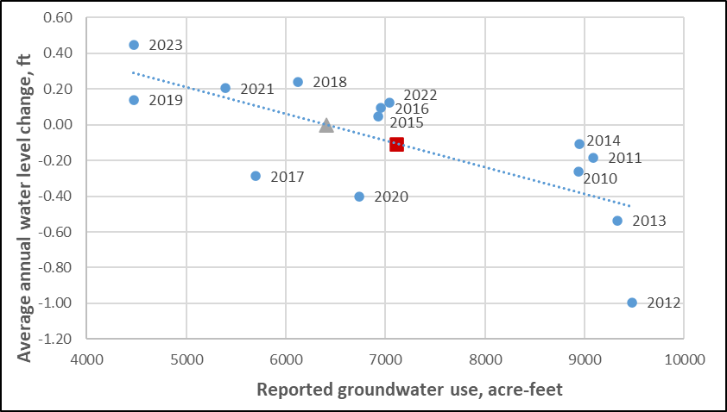
Wichita County Southwest
R-squared = 0.51, P < 0.005
Average 2010-2023:
  Water-level change = -0.11 ft
  Total reported use = 7,114 AF
Average 2019-2023:
  Water-level change = 0.103 ft
  Total reported use = 5,623 AF
Net Inflows = 6,412 AF
Percent reduction for stable water levels:
  Average conditions = 10%
  Drought (2011) = 29%
  Last 5 years = 0%
Kansas Geological Survey

Slide 12
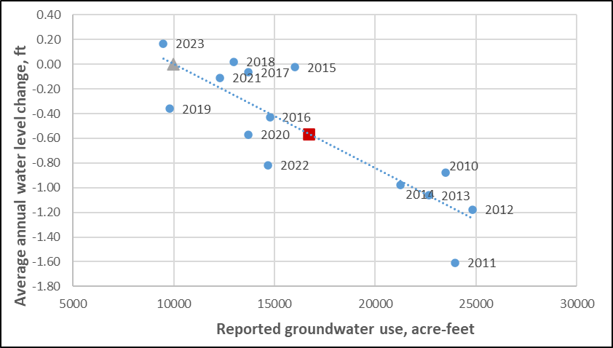
Wichita County Northwest
R-squared = 0.72, P < 0.0002
Average 2010-2023:
  Water-level change = -0.56 ft
  Total reported use = 16,681 AF
Average 2019-2023:
  Water-level change = -0.34 ft
  Total reported use = 11,981 AF
Net Inflows = 9,987 AF
Percent reduction for stable water levels:
  Average conditions = 40%
  Drought (2011) = 58%
  Last 5 years = 17%
Kansas Geological Survey

Slide 13
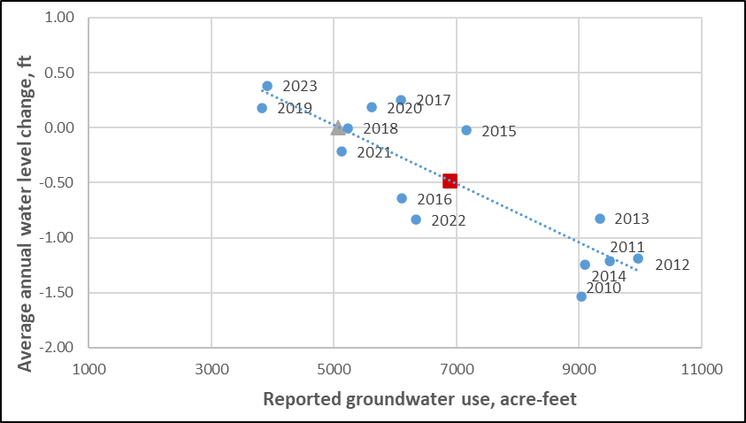
Wichita County Township 16S 38W
R-squared = 0.74, P < 0.00009
Average 2010-2023:
  Water-level change = -0.48 ft
  Total reported use = 6,883 AF
Average 2019-2023:
  Water-level change = -0.06 ft
  Total reported use = 4,963 AF
Net Inflows = 5,073 AF
Percent reduction for stable water levels:
  Average conditions = 26%
  Drought (2011) = 46%
  Last 5 years = 0%
Kansas Geological Survey

Slide 14
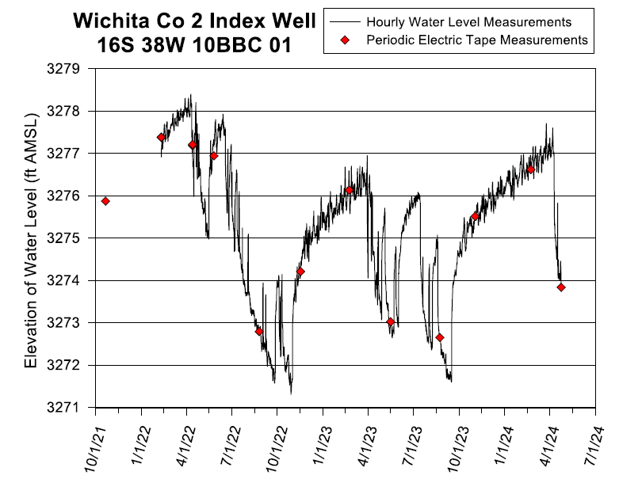
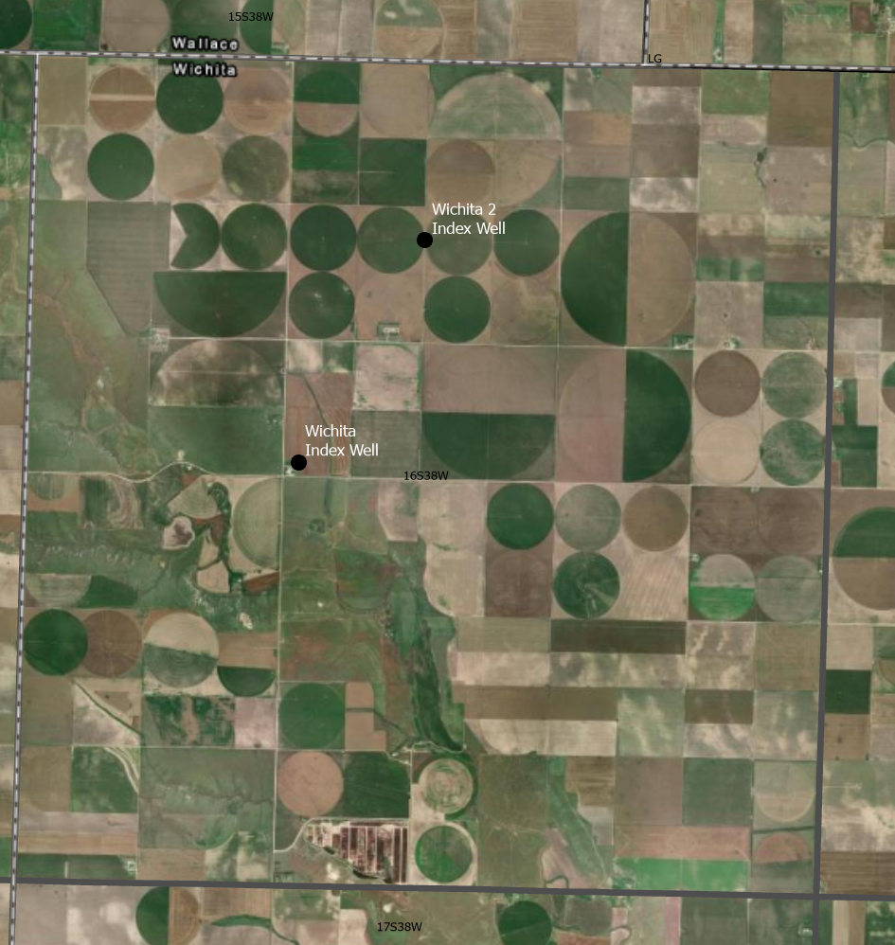
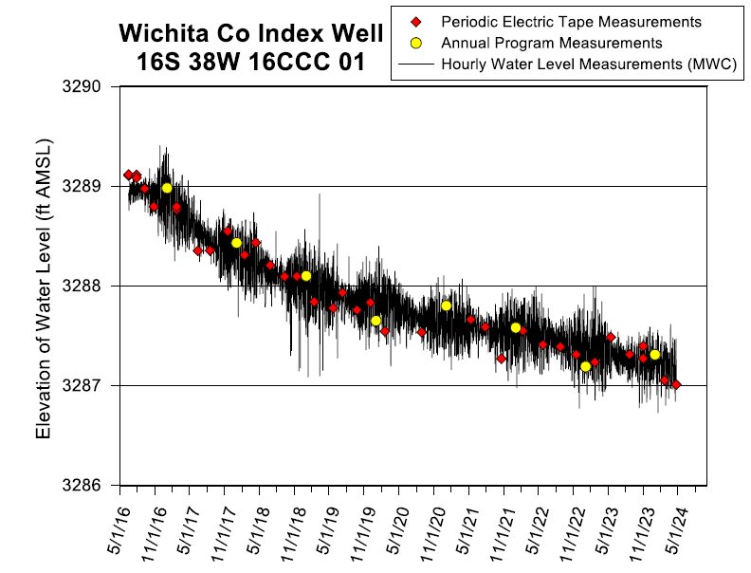
Wichita County Township 16S 38W, Index Wells
Kansas Geological Survey

Slide 15
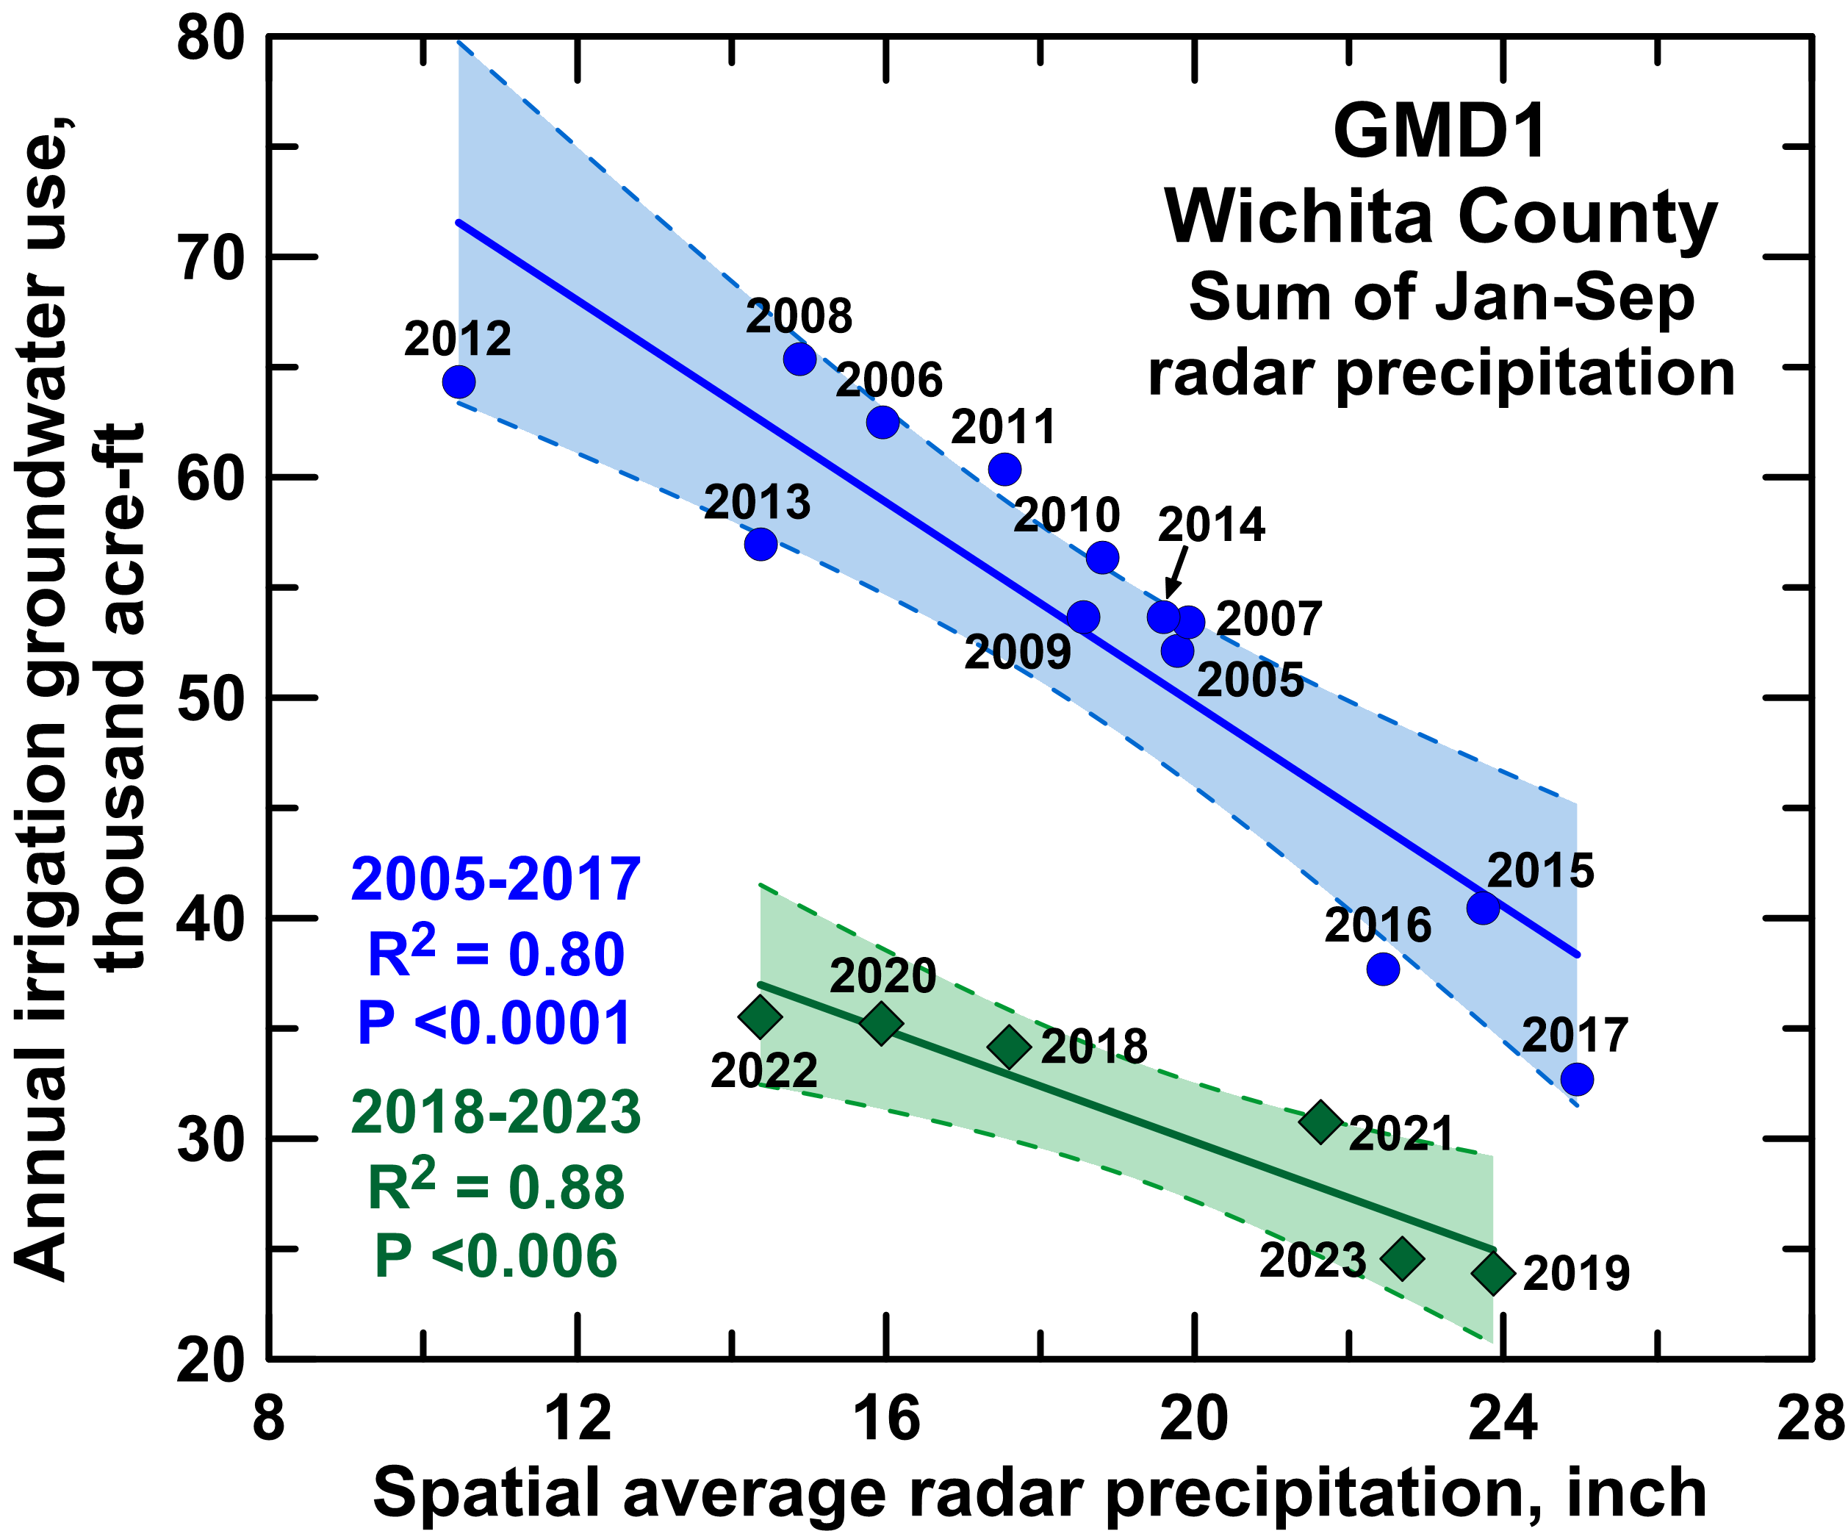
Wichita County
On average, 40% decrease in water use for similar climatic conditions.
- about 25% produced by improvement in irrigation efficiency.
- about 15% produced by a decrease in irrigated area (reported decrease 19.9%).
Kansas Geological Survey

Slide 16
Wichita County
R-squared = 0.81, P < 0.00002
Average 2010-2023:
  Water-level change = -0.35 ft
  Total reported use = 44,066 AF
Average 2019-2023:
  Water-level change = -0.098 ft
  Total reported use = 32,351 AF
Net Inflows = 33,602 AF
Percent reduction for stable water levels:
  Average conditions = 24%
  Drought (2011) = 46%
  Last 5 years = 0%
Kansas Geological Survey

Slide 17
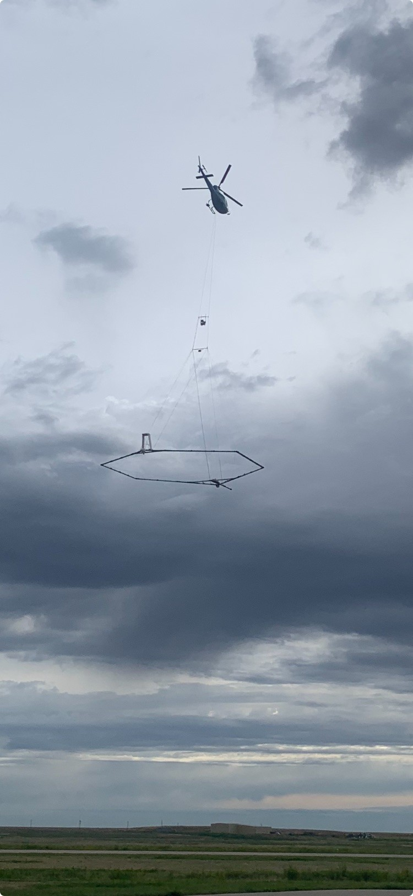
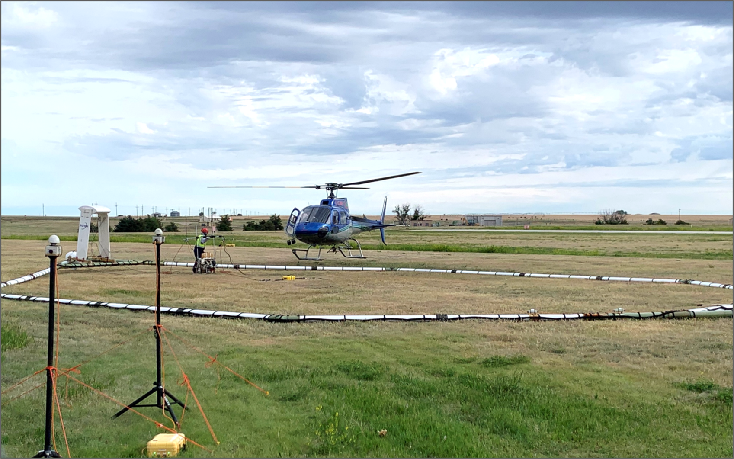
Airborne Electromagnetic (AEM) Survey

Slide 18
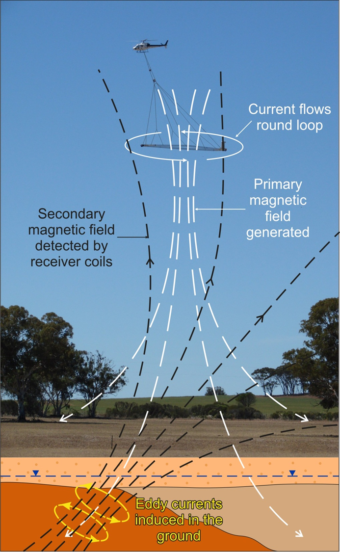
How AEM works:
The transmitter fires discrete electromagnetic pulses that generate a primary magnetic field.
The pulses induce eddy currents in the subsurface that generate a secondary magnetic field, i.e. the “response”.
The receiver “listens” for this response – we are measuring this secondary magnetic field.
This measurement provides information on electrical resistivities in the subsurface. Sands and gravels have higher resistivities, while clays, silts, and shale bedrock have lower resistivities.

Slide 19
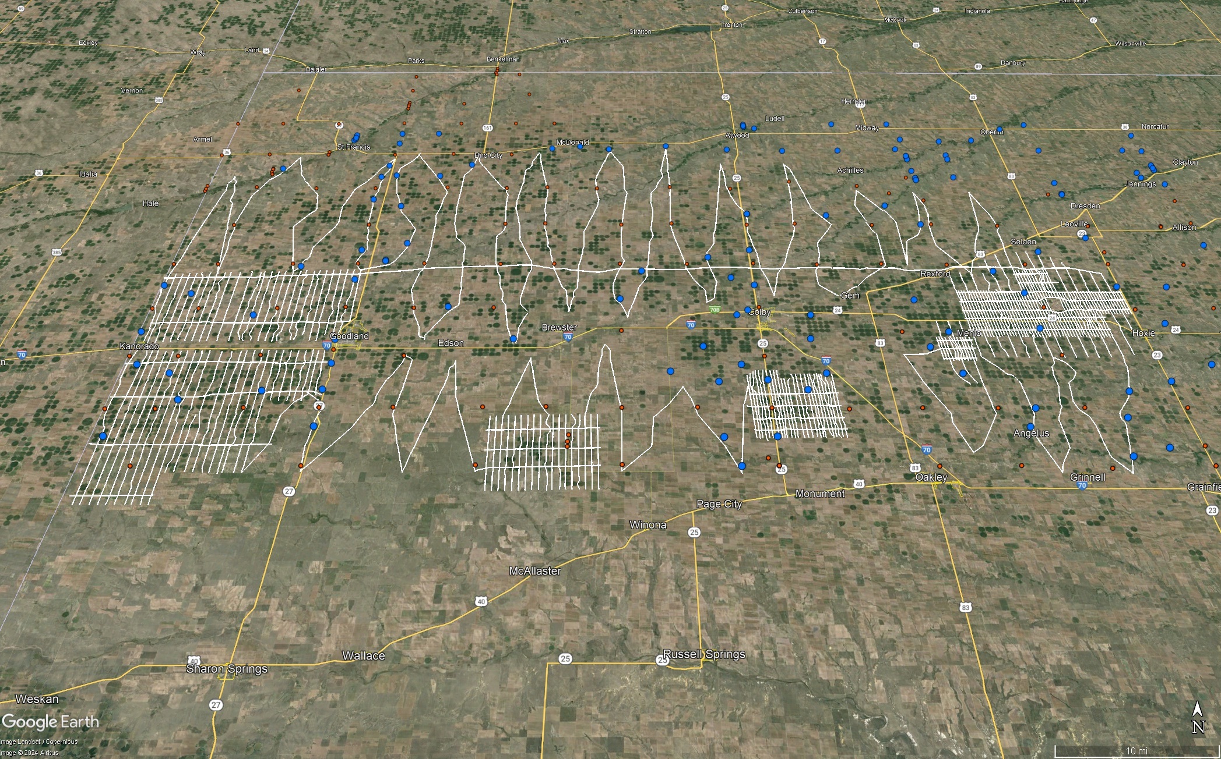
GMD4 Flights Lines – 2,443 miles (3,932 km) – May 28-June 16, 2024

Slide 20
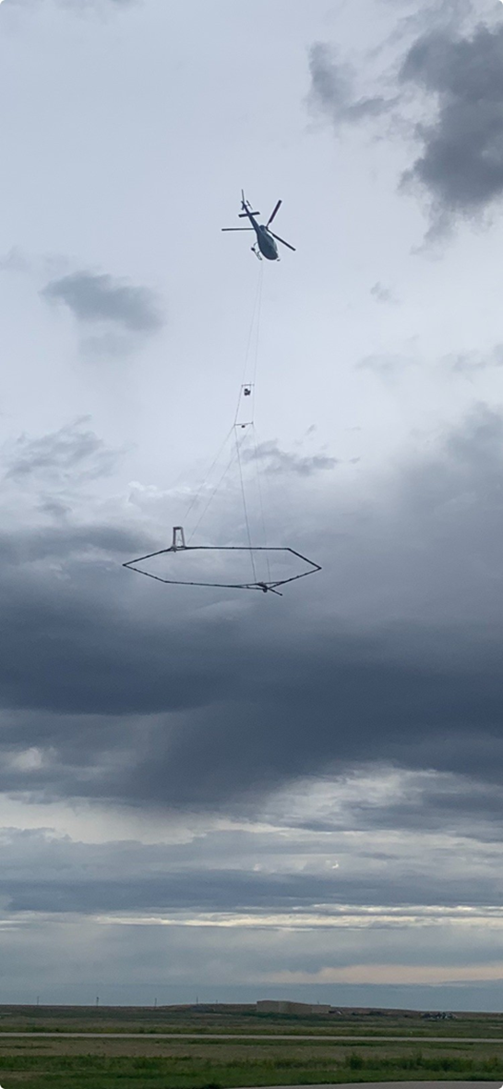
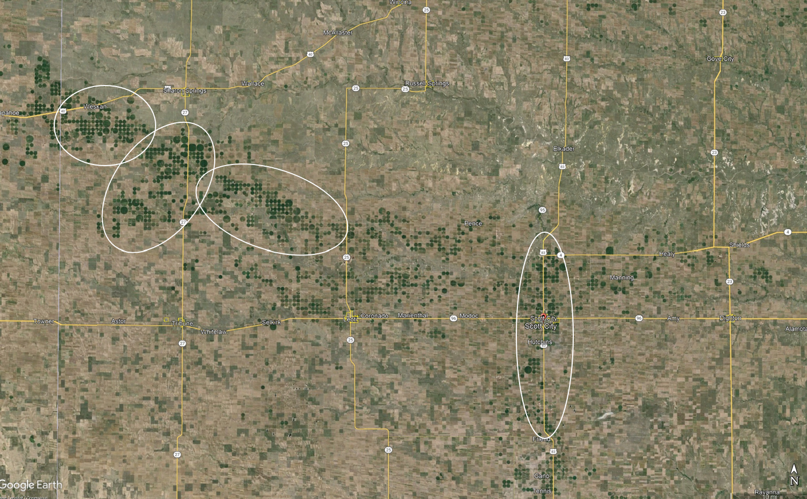
GMD1 Timing – June 2025

Slide 21

Questions????
Kansas Geological Survey
1930 Constant Ave
Lawrence, KS 66047
785-864-2118
Visit our site at http://www.kgs.ku.edu
Notes:
Thank You!

